Slide 1
DS745 - Exploring Player Value Through Goals Added
File created on: 11/3/22 11:22:24 PM CDT

Slide 2
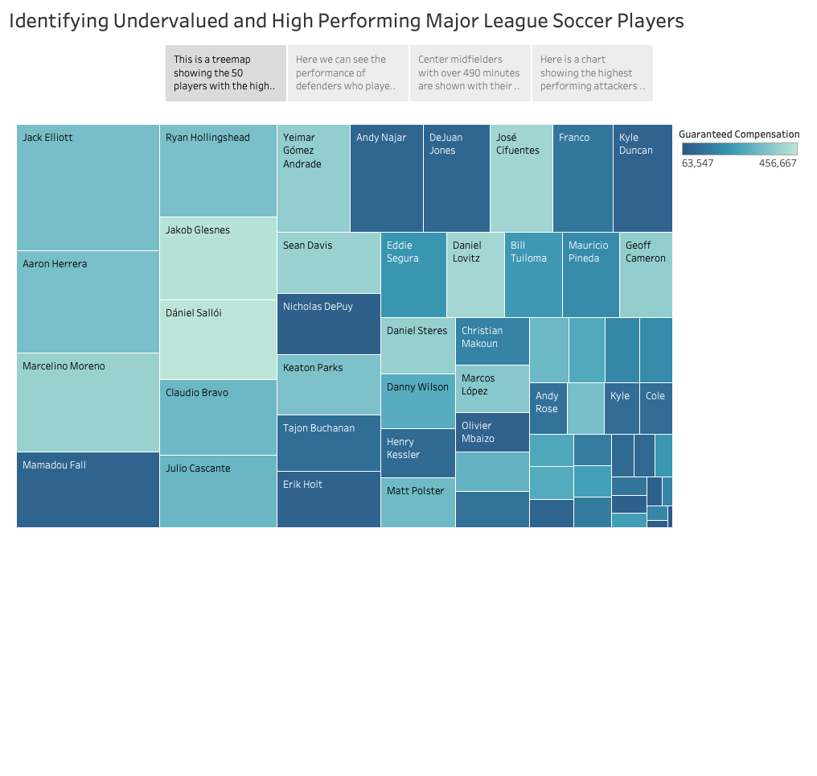

Slide 3
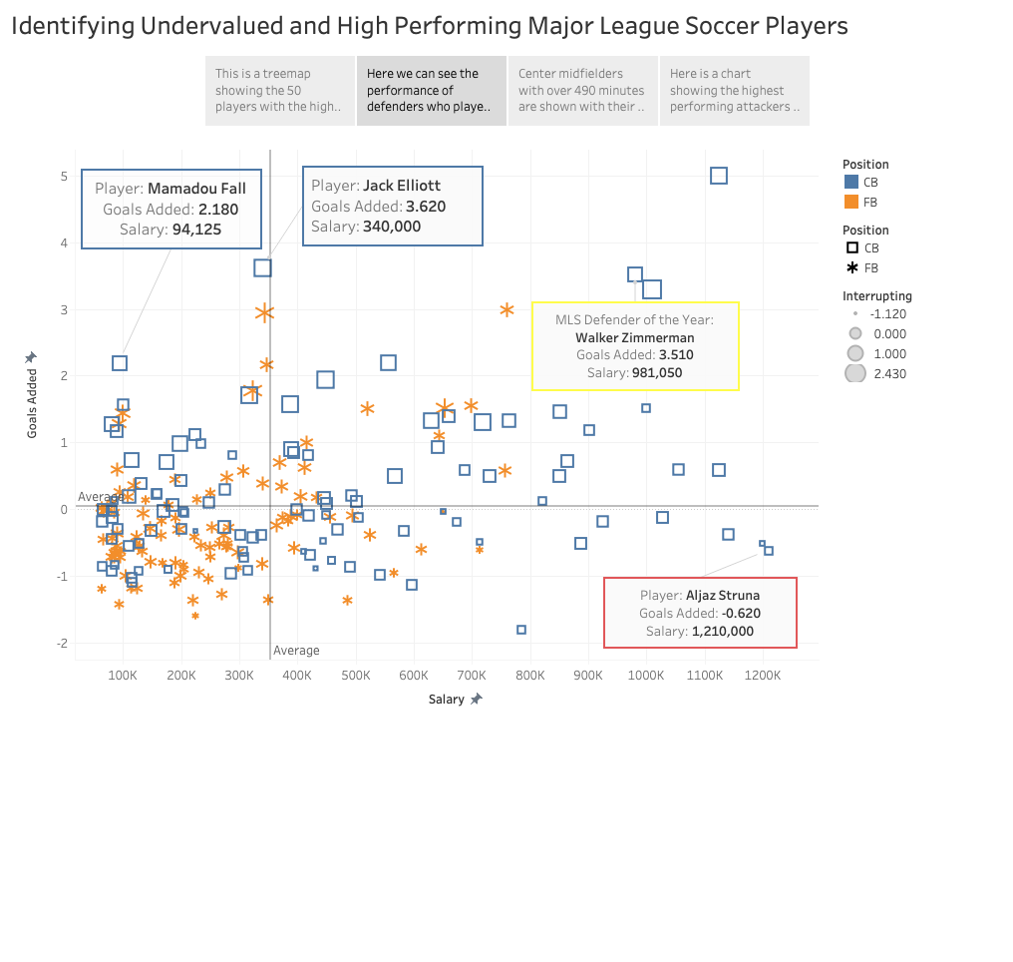

Slide 4
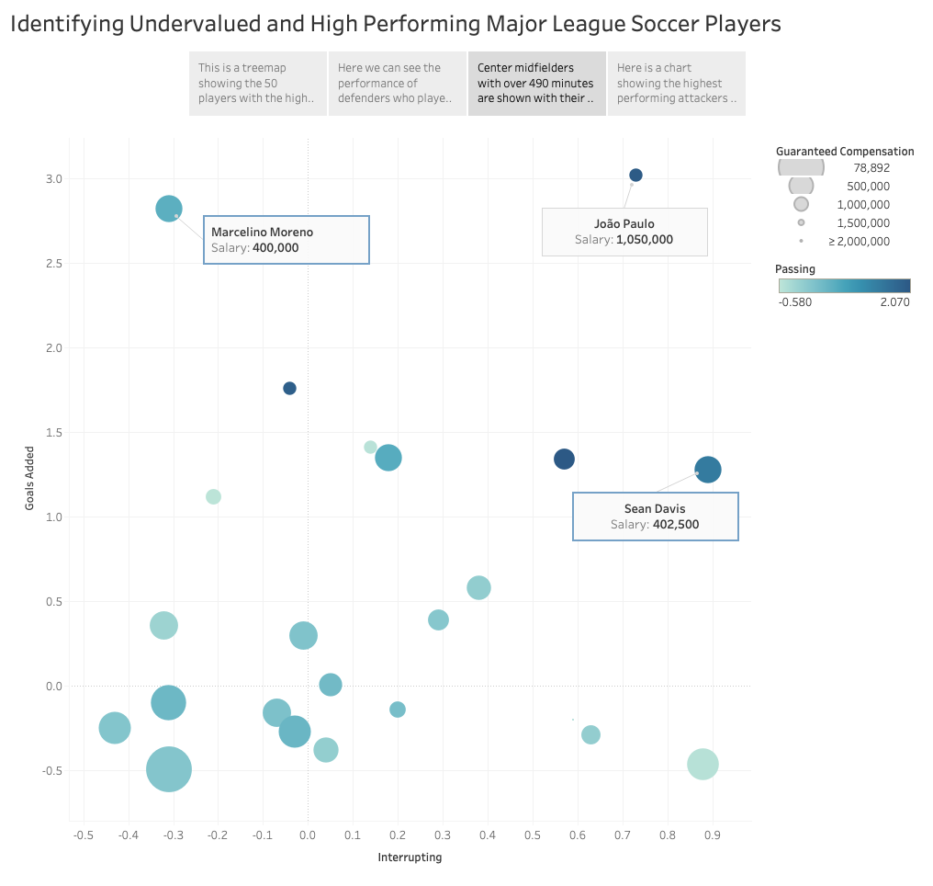

Slide 5
